Slide 1




Generative Adversarial Network (GAN) for Synthetic Terrain Generation
Replacing traditional random noise with deep learning to synthesize realistic 3D elevation maps and landscapes.
TEAM MEMBER 1
TEAM MEMBER 2
TEAM MEMBER 3
Mahesh Paul J
David Bobby Abraham
Ishan Chadha
Reg. No: [RA2212702010006]
Reg. No: [RA2212702010015]
Reg. No: [RA2212702010022]

Slide 2


Project Abstract
The Objective
The Proposed Solution
Digital terrains and heightmaps are crucial for video games, flight simulators, and virtual worlds. Currently, building realistic terrains takes either weeks of manual 3D design work or complex simulation tools.
Instead of relying on random mathematical formulas, we use a Generative Adversarial Network (GAN) trained on real-world satellite elevation data.
The network learns real geological structures like mountain peaks, valleys, and erosion patterns producing lifelike terrains that look naturally formed.
Our project aims to create an automated AI model that generates realistic, continuous 2D heightmaps in seconds from simple random inputs.

Slide 3

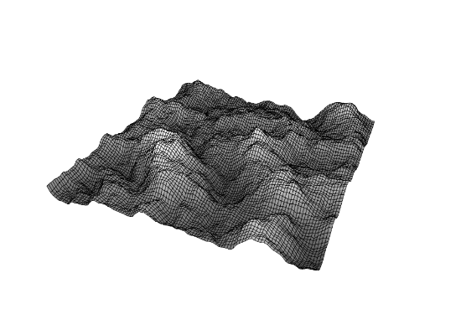
Old Method: Procedural Noise
How It Traditional Tools Work
Traditional terrain synthesis relies on mathematical noise algorithms, most commonly Perlin Noise or Simplex Noise:
Pure Mathematics: Overlays random smooth waves at multiple frequencies to create rolling hills.
No Geological Realism: Cannot understand true planetary processes like river drainage, tectonic ridges, or mountain weathering.
Tedious Tuning: Creating specific landforms requires manually tweaking dozens of arbitrary parameters.

Slide 4
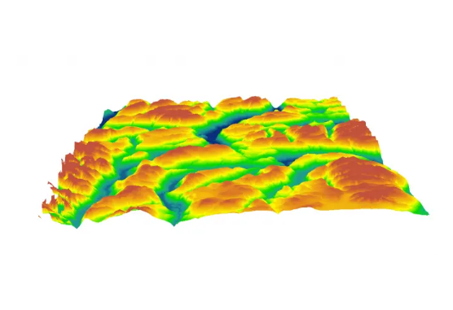
Our Method: Deep Learning (GANs)
A Simple Two-Player Competition
A Generative Adversarial Network trains two neural networks against each other to produce realistic heightmaps:
The Generator: Takes a random vector (noise) and tries to draw a 2D elevation heightmap.
The Discriminator: Examines heightmaps and guesses whether they are real satellite scans or AI fakes.
The Result: Through competition, the Generator learns to output realistic valleys, ridges, and slopes that fool the Discriminator.

Slide 5


Noise vs. Deep Learning
Traditional Noise (Perlin)
Our GAN Approach
Repetitive Patterns: Landscapes look generic, rolling, and artificially smoothed.
Natural Features: Captures true geographical ridges, valleys, and runoff paths.
Rigid Rules: Difficult to naturally blend different biomes (e.g., plains into mountains).
Smooth Interpolation: Seamlessly morphs between different terrain types.
No Learning: Never improves or learns from real elevation data.
Data-Driven: Learns directly from satellite heightmap datasets.

Slide 6
Thank You

